Slide 1
軟體工程設計
Term Project
許庭瑋、陳君翰、洪世彬、劉玠均、楊昕叡、林俊佑
2023/12/14

Slide 2
Overview

Slide 3
Code Tracing Summary (WBS) - W2 to W13
 | Part | Expected (hr) | Actual (hr) | LOC
spring-core-core
許庭瑋 | io | 108 | 149 | 6100
楊昕叡 | annotation | 99.5 | 65.5 | 6070
劉玠均 | convert, type, serializer | 78 | 76 | 6396
洪世彬 | core separated java files | 28 | 26.5 | 6853
spring-core-aot, spring-core-cglib
陳君翰 | spring-core-cglib [sub], spring-core-aot | 148 | 168.4 | 6367
林俊佑 | spring-core-cglib [main] | 26 | 36 | 7557

Slide 4
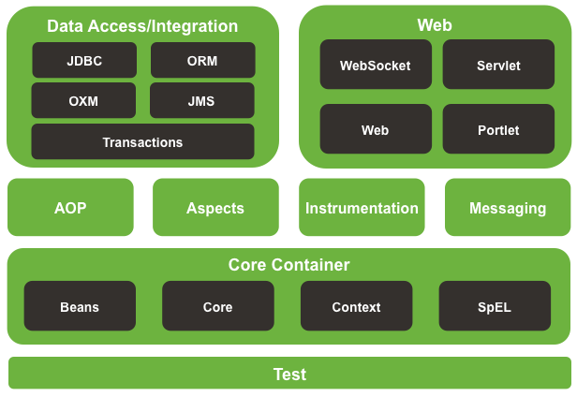
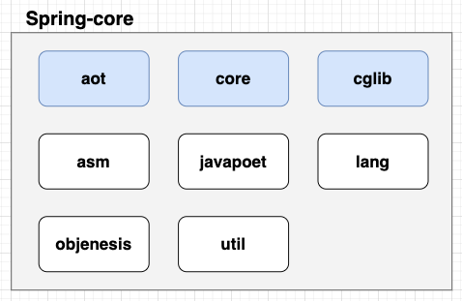
System Overview (spring-core)
Presenter: 洪世彬

Slide 5
Spring Framework Core - core
Presenter: 洪世彬、許庭瑋、楊昕叡、劉玠均

Slide 6
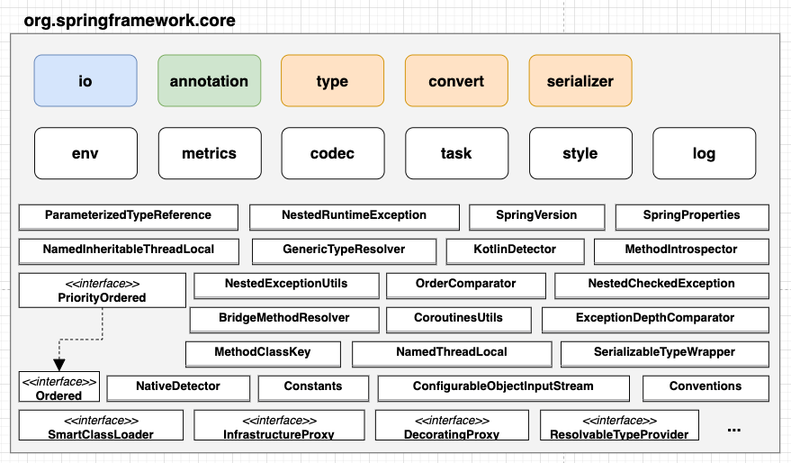
System Overview (org.springframework.core)
Presenter: 洪世彬

Slide 7
Packages
Presenter: 洪世彬
core.env: Manages environmental information, including profiles, properties, and various configuration details.
core.metrics: Recording metrics about a particular phase or action happening during the ApplicationStartup
core.codec: Implements various types of Encoder and Decoder functionalities.
core.task: Manages the execution of synchronous and asynchronous tasks.
core.style: Specifies diverse styles for the ToString method.
core.log: Extends common logging capabilities.
others: Provides utilities for internal use, including Registry, Sorting, Exceptions, and more.

Slide 8
Design Patterns
Presenter: 洪世彬
Creational
Factory Method
Singleton
Structural
Adapter
Decorator
Composite
Behavioral
Iterator
Null Object
Strategy

Slide 9
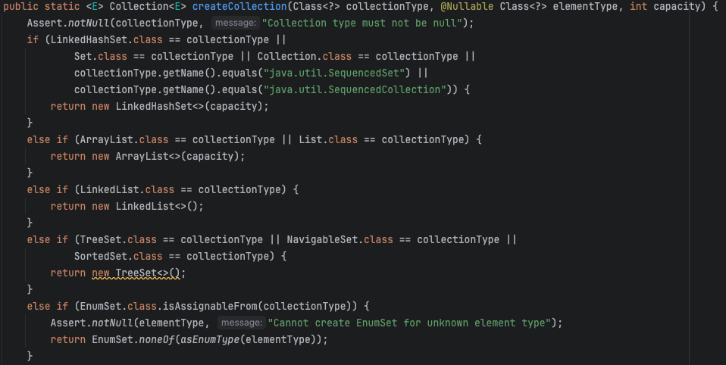
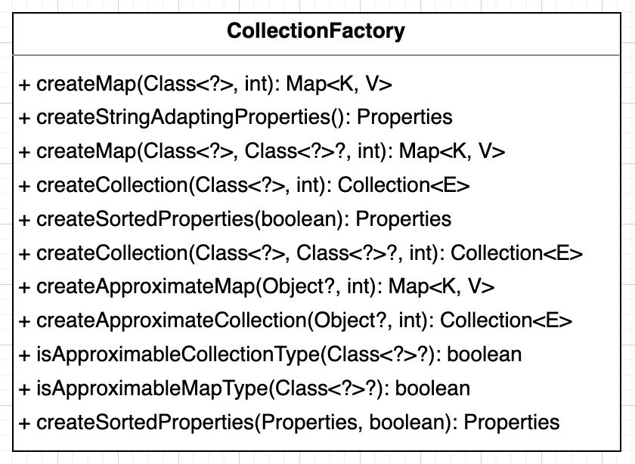
Factory Method
Presenter: 洪世彬
CollectionFactory
Implemented using static factory.

Slide 10
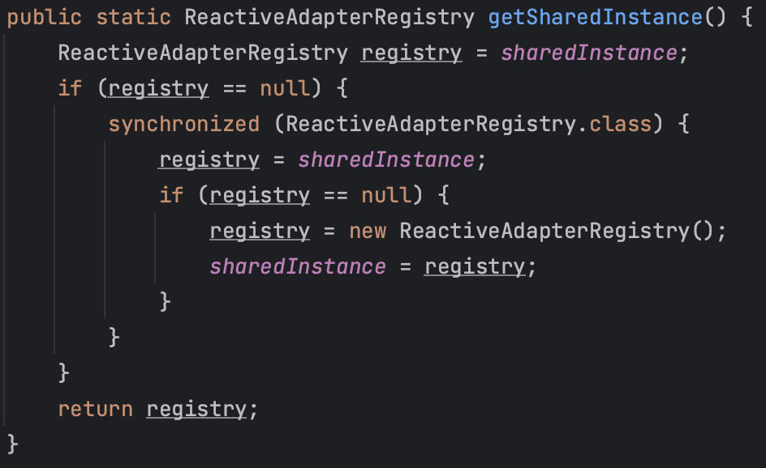
Singleton
Presenter: 洪世彬
ReactiveAdapterRegistry
Since it aims to create a global Adapter repository and avoids having multiple instances within the program, it adopts the Singleton Pattern.

Slide 11
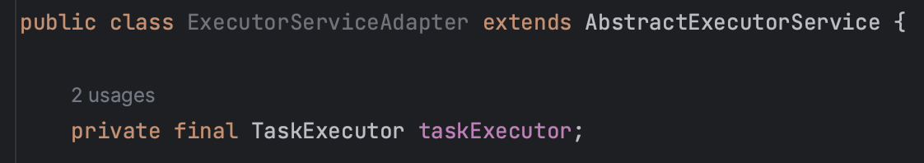
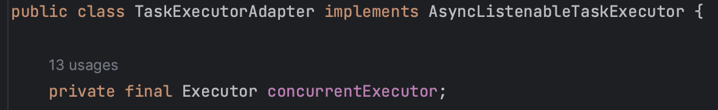
Adapter
Presenter: 洪世彬
ExecutorServiceAdapter, TaskExecutorAdapter
Both classes uses Object-level Adapter Pattern.

Slide 12
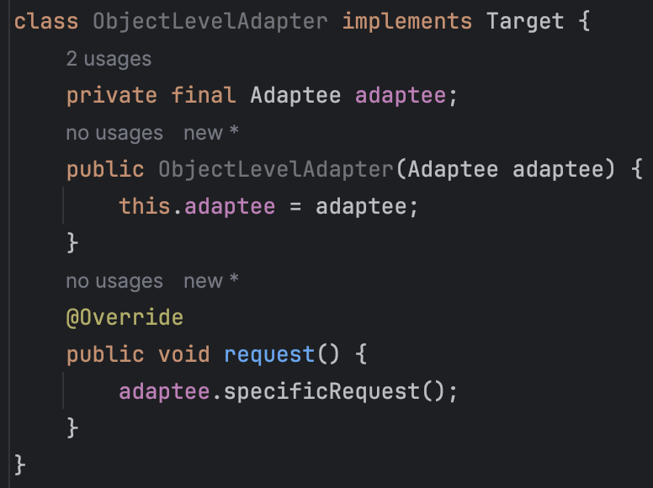
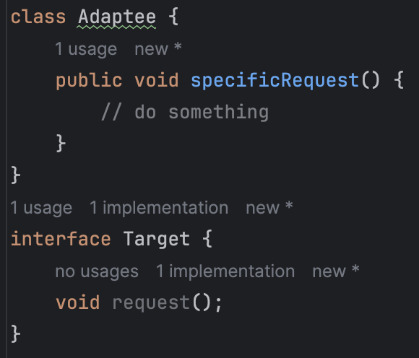
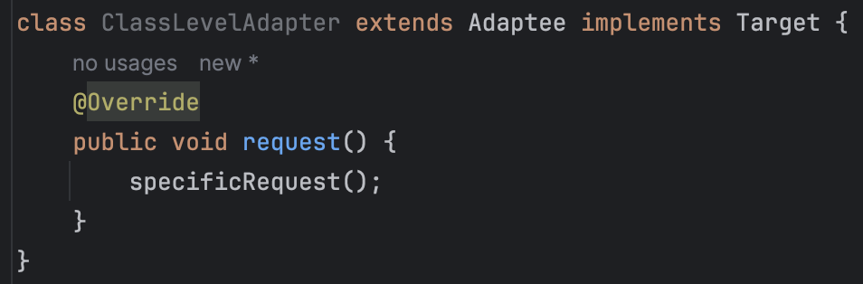
Object-level (Composition):
Implement the target interface and obtain a reference of adaptee.
Class-level (Inheritance):
Extend adaptee and implement target interface at the same time.

Slide 13
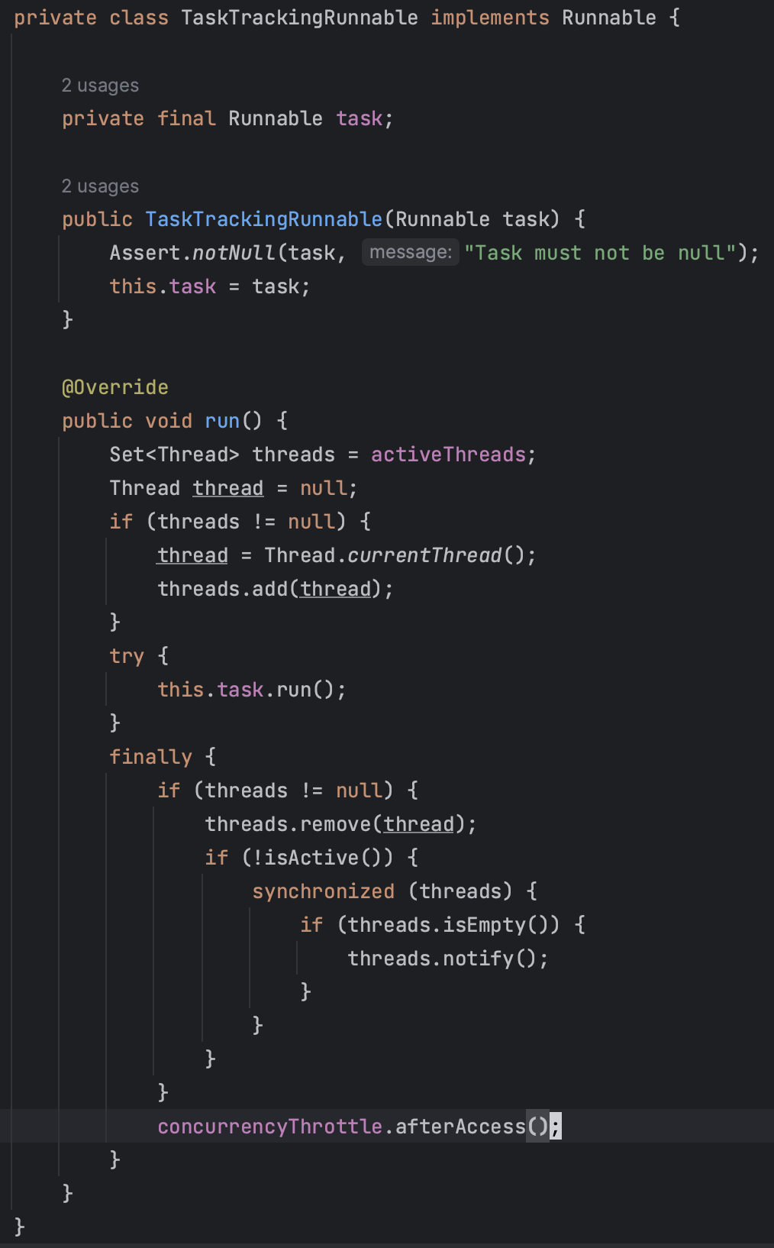
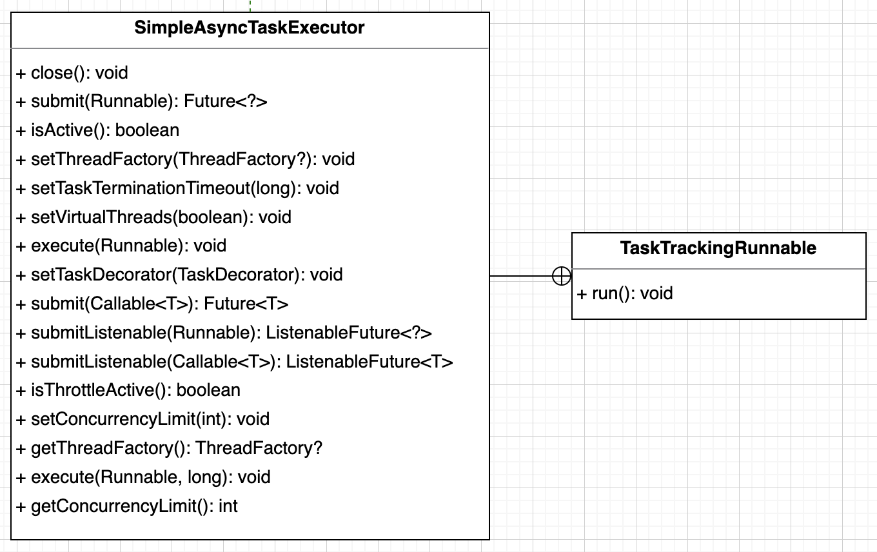
Decorator
Presenter: 洪世彬
TaskTrackingRunnable

Slide 14
Decorator (Added After Presentation)
Presenter: 洪世彬
TaskTrackingRunnable use Decorator pattern to enhance the functionality of a Runnable Object by adding tracking features.
TaskTrackingRunnable is employed to track all threads currently involved in executing the task. Before the inner class is actually executed, the current thread is added to a set. After the execution is completed, the thread is removed from the set.

Slide 15
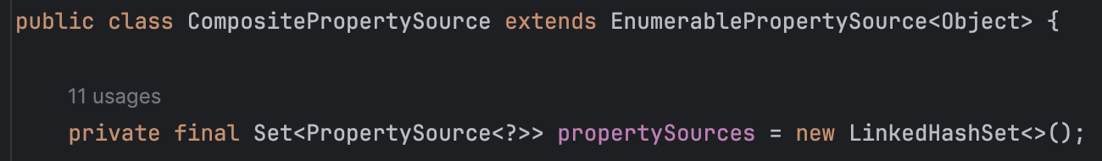
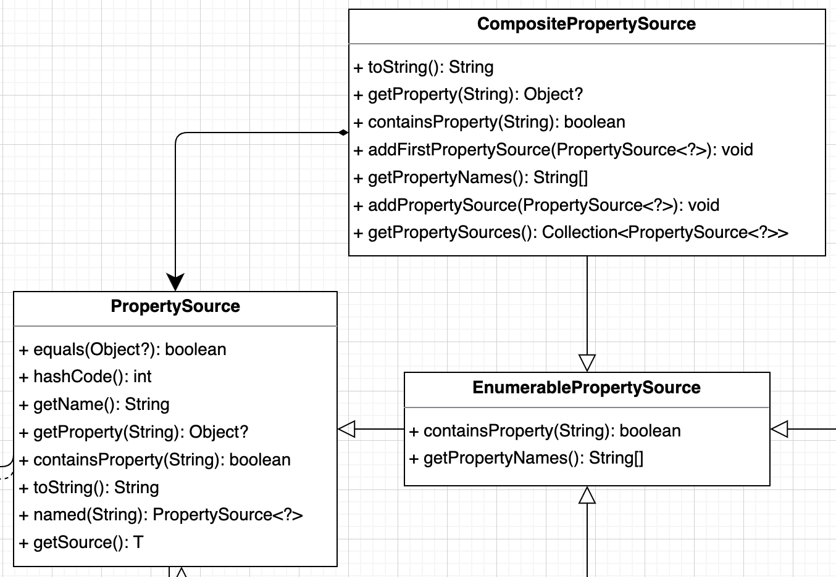
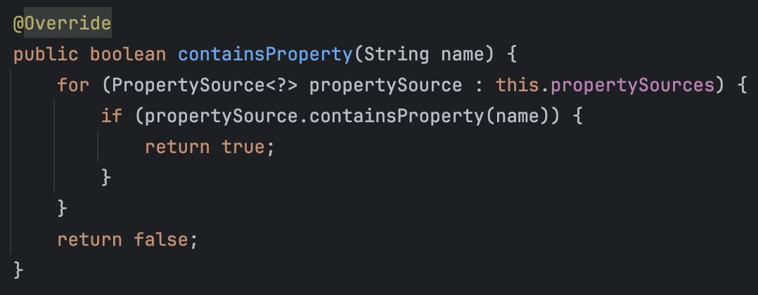
Composite
CompositePropertySource
Presenter: 洪世彬

Slide 16
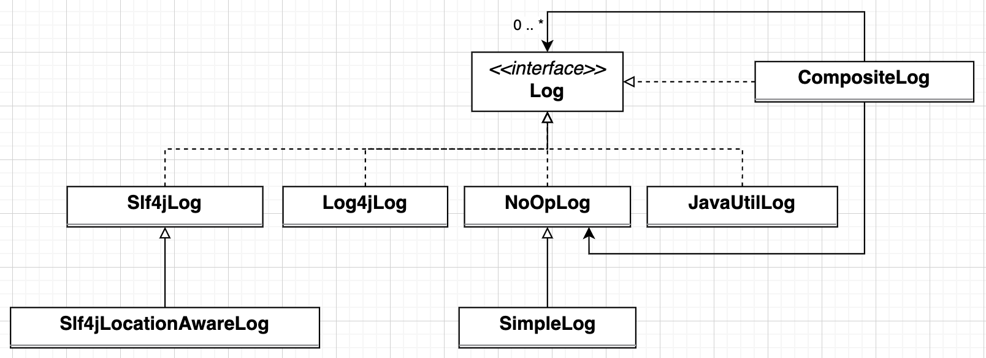
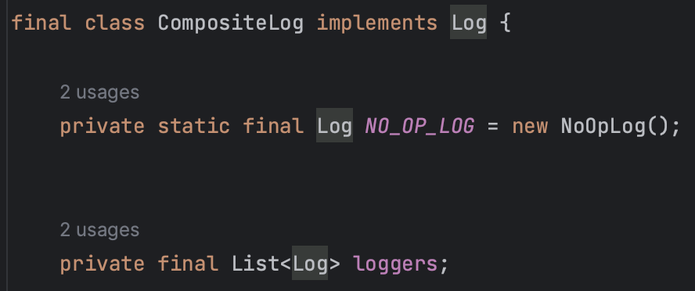
Composite
(Added After Presentation)
Presenter: 洪世彬
CompositeLog

Slide 17
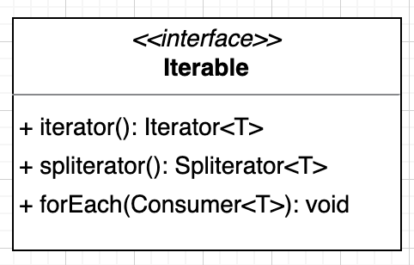
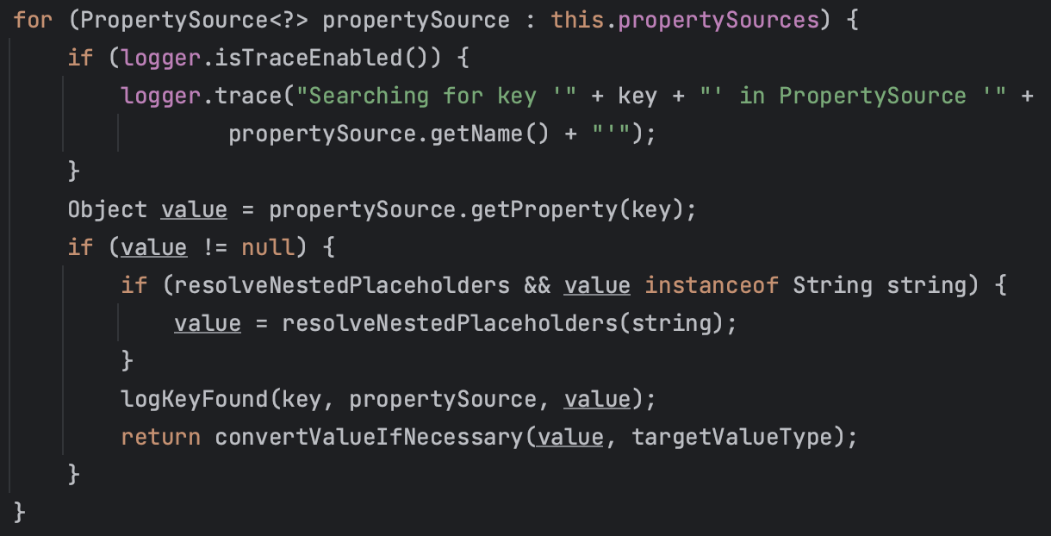
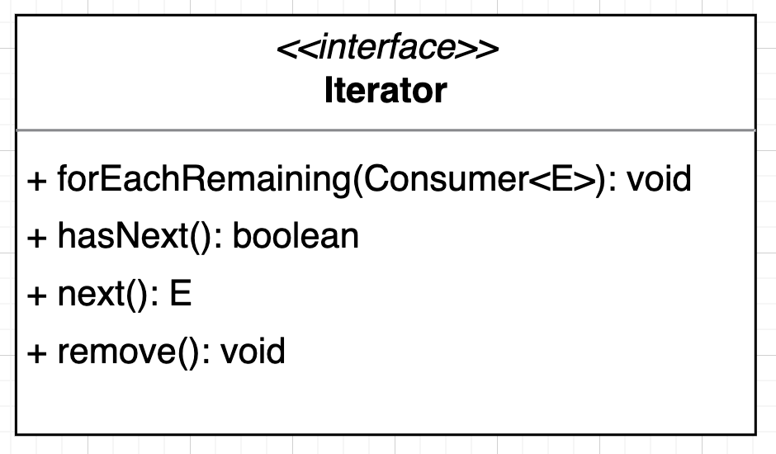
Iterator
Presenter: 洪世彬
PropertySources

Slide 18
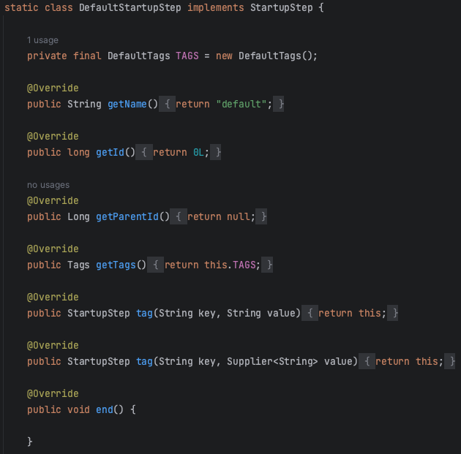
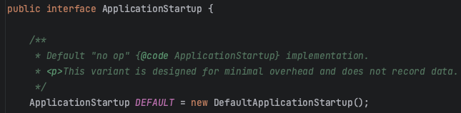
Null Object
Presenter: 洪世彬
ApplicationStartup
ApplicationStartup uses the Null Object Pattern to provide a default behavior, DefaultApplicationStartup.

Slide 19
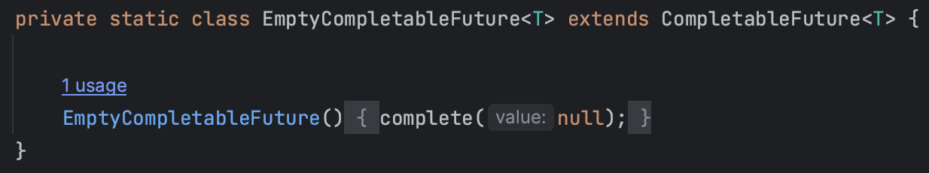
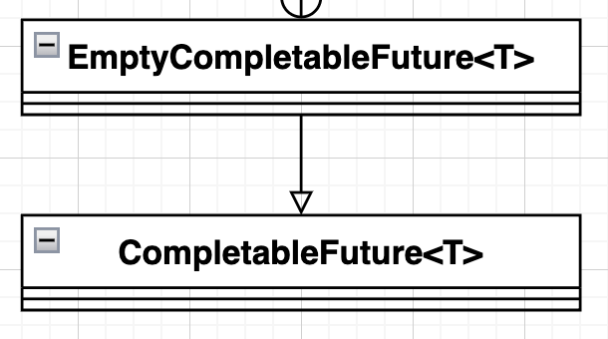
Null Object
Presenter: 洪世彬
EmptyCompletableFuture

Slide 20
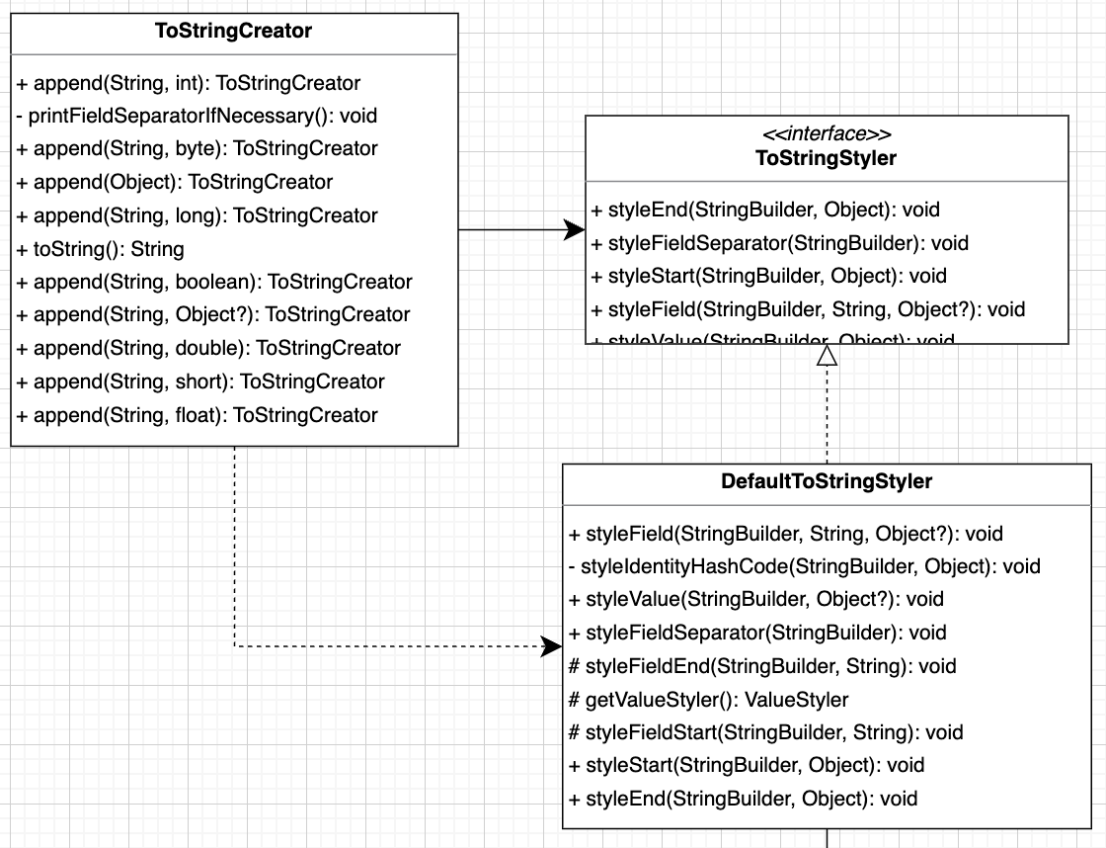
Strategy
Presenter: 洪世彬
ToStringStyler
ToStringStyler is a strategy interface for pretty-printing toString() methods. It allows users to convert any object into a String representation.

Slide 21
Spring-core-core-io
Presenter: 許庭瑋
Resource
In order to unify various types of different resources
Null object pattern
DataBuffer
provide a convenient wrapper around ByteBuffer
Factory pattern, Iterator pattern
Support
Support classes for Spring's resource abstraction
Strategy pattern, Factory pattern

Slide 22
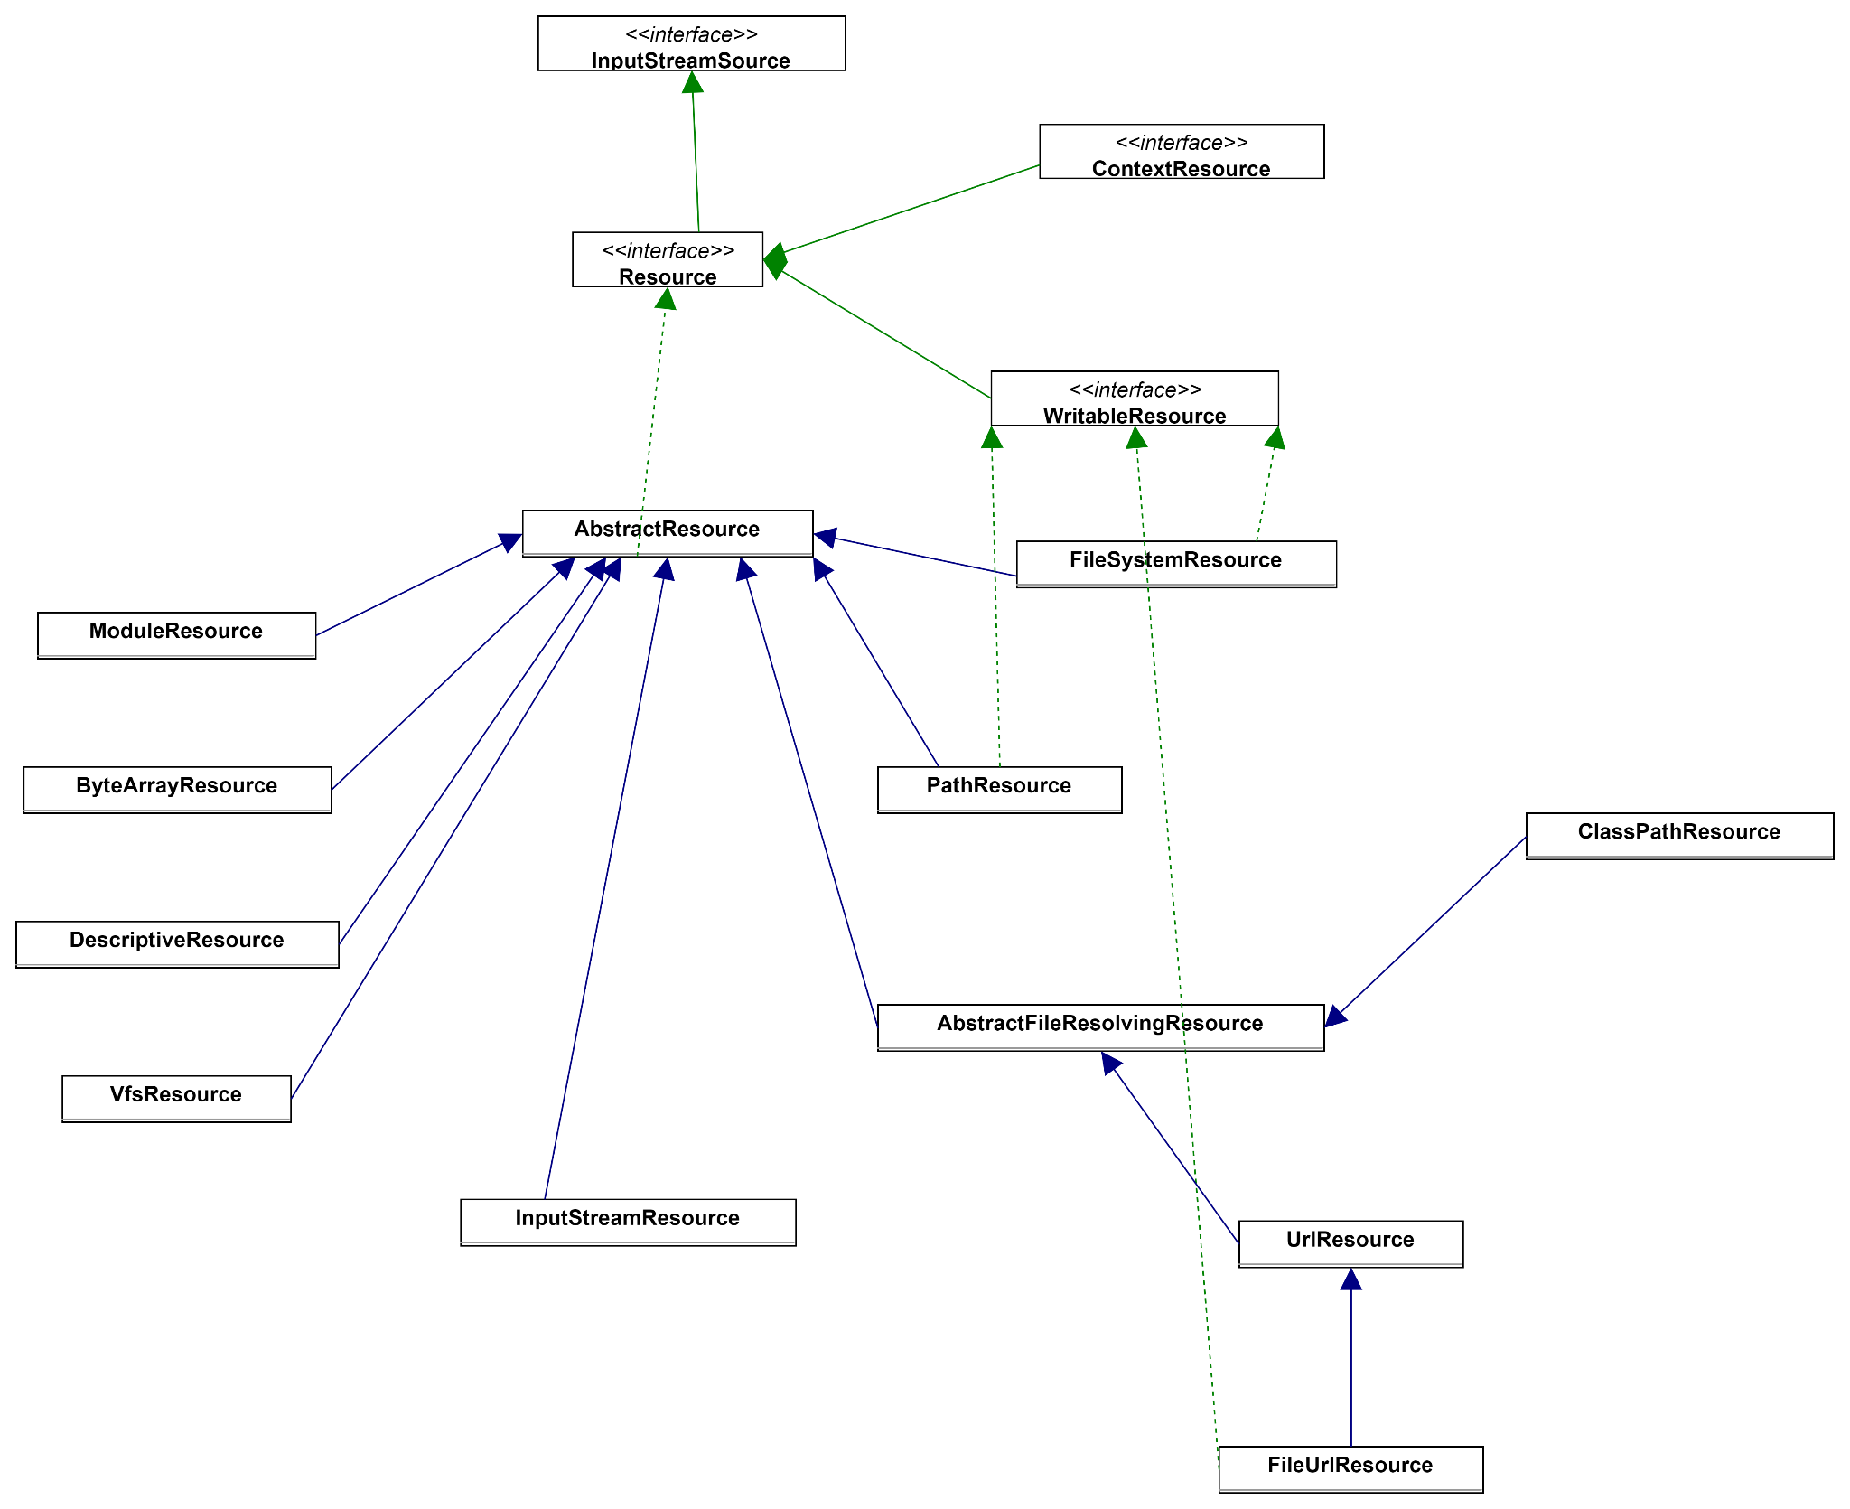
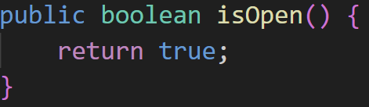
Resource
Presenter: 許庭瑋
Null object pattern --
InputStreamResource
many extentions
and implementations
of Resource

Slide 23
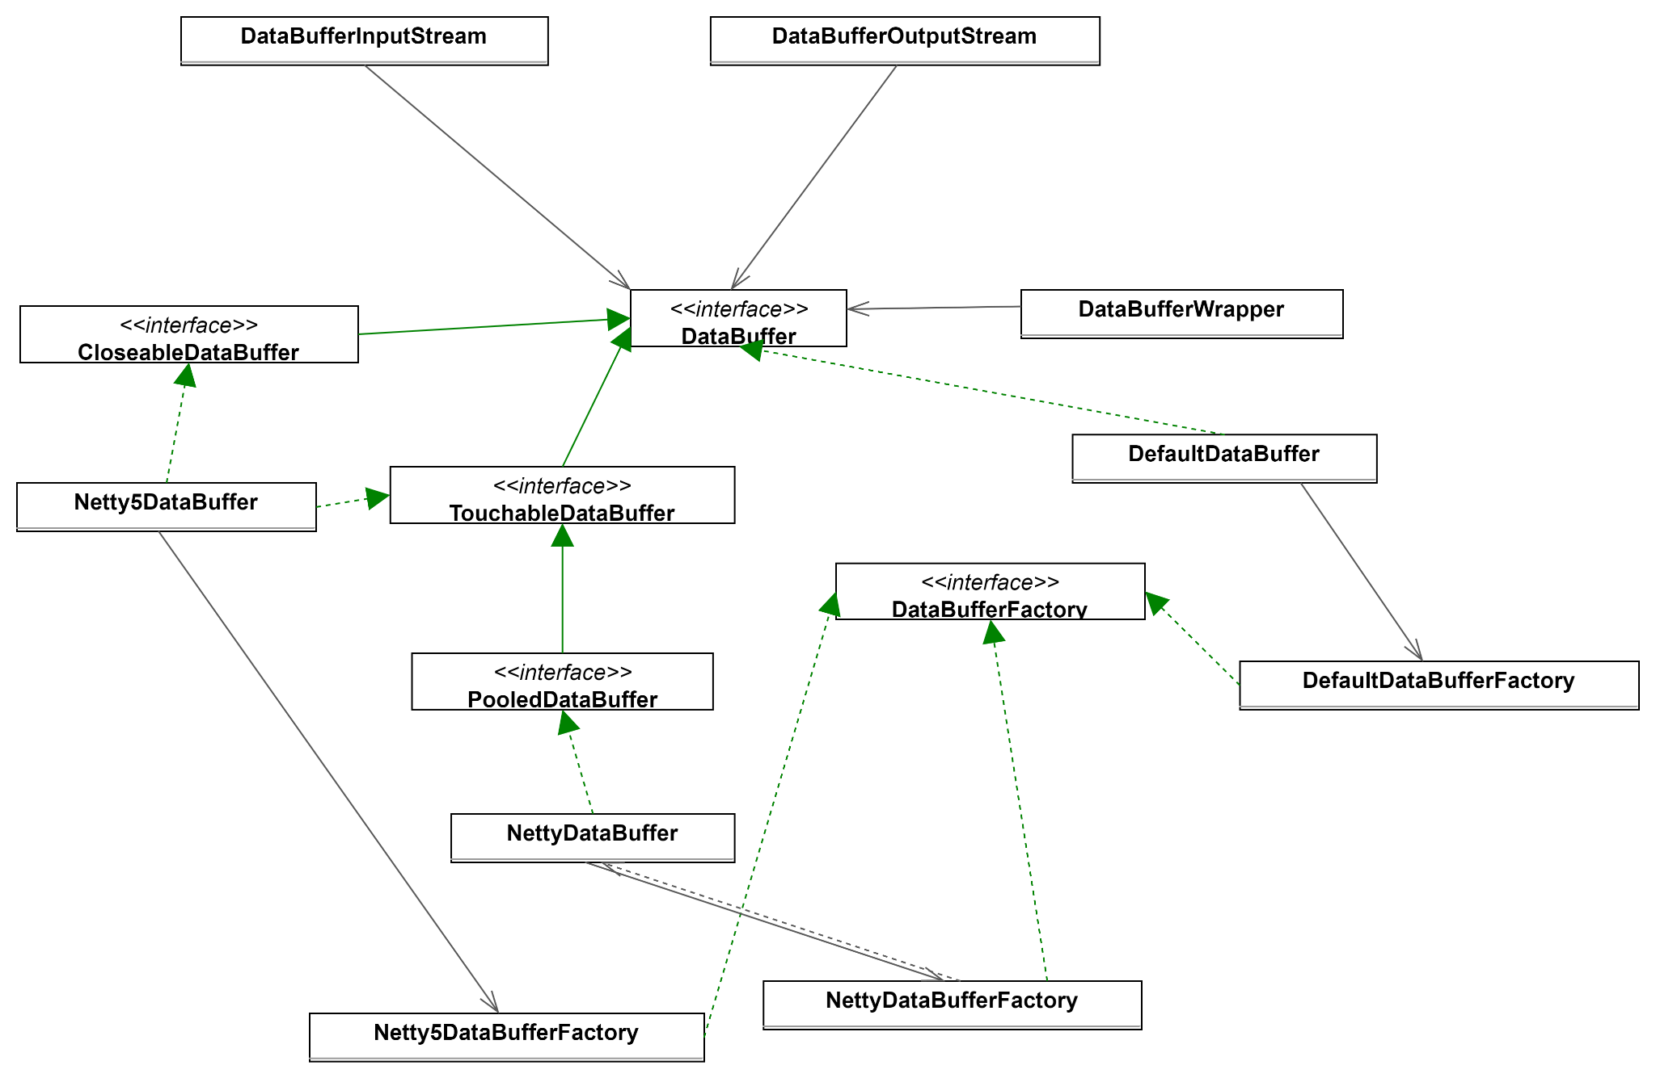
DataBuffer
Presenter: 許庭瑋
Factory pattern
types of buffer:
io.netty5.buffer.Buffer
io.netty.buffer.ByteBuf
java.nio.ByteBuffer

Slide 24
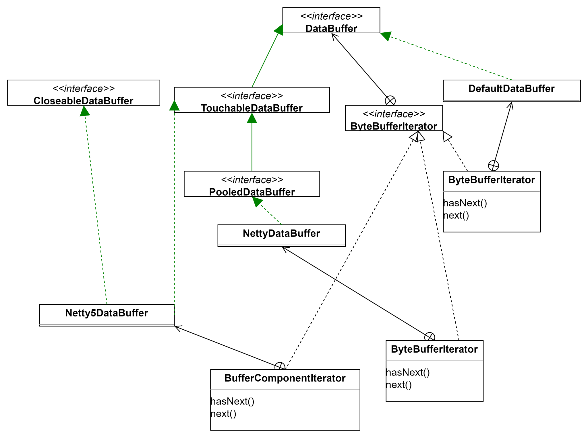
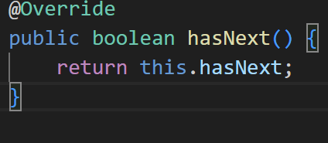
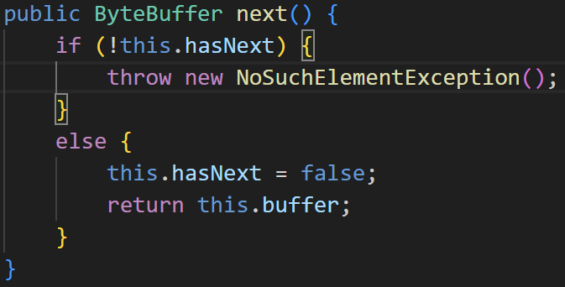
DataBuffer
Presenter: 許庭瑋
Iterator pattern

Slide 25
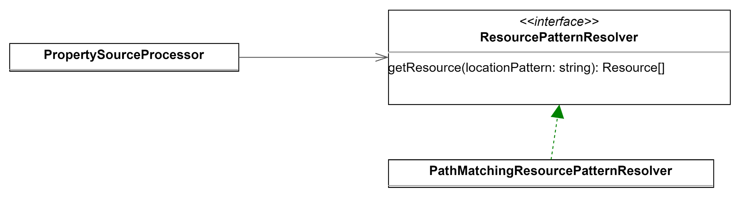
Support
Presenter: 許庭瑋
Support classes for Spring's resource abstraction
Strategy pattern -- ResourcePatternResolver

Slide 26
Support
Presenter: 許庭瑋
Factory pattern -- PropertySourceFactory
In fact, PropertySource is in core.env, but PropertySourceFactory is in core.io.support, I guess it's because PropertySource is related to environment, but not used in core.env. It is used in core.io.support, so there is a factory in core.io.support

Slide 27
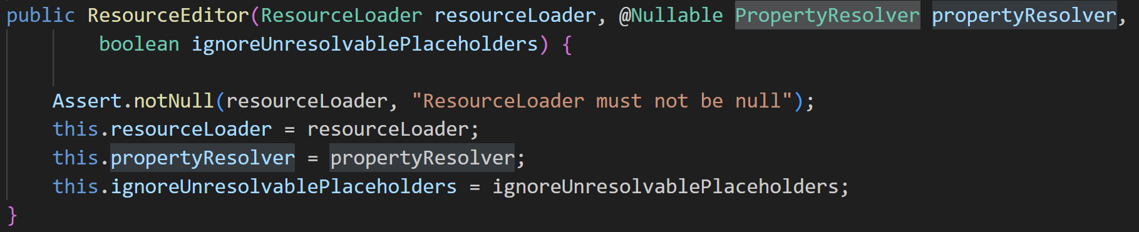
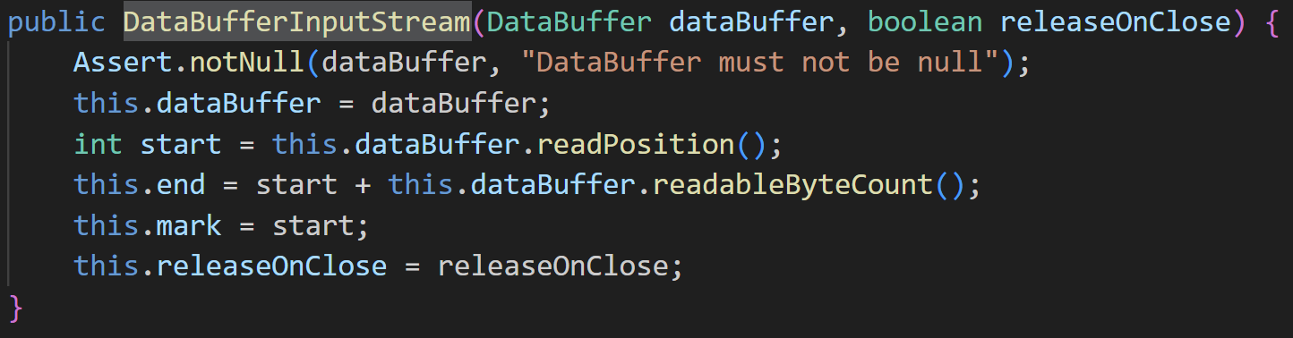
Dependency Injection
Presenter: 許庭瑋
Constructor injection
ResourceLoader and PropertyResolver in ResourceEditor
DataBuffer in DataBufferInputStream

Slide 28
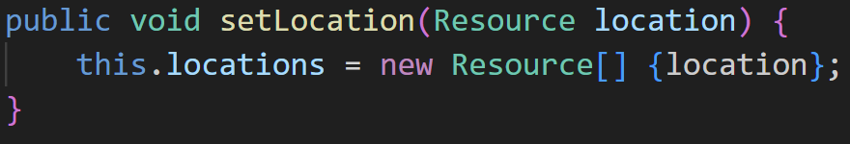
Dependency Injection
Presenter: 許庭瑋
Setter injection
Resource in PropertiesLoaderSupport

Slide 29
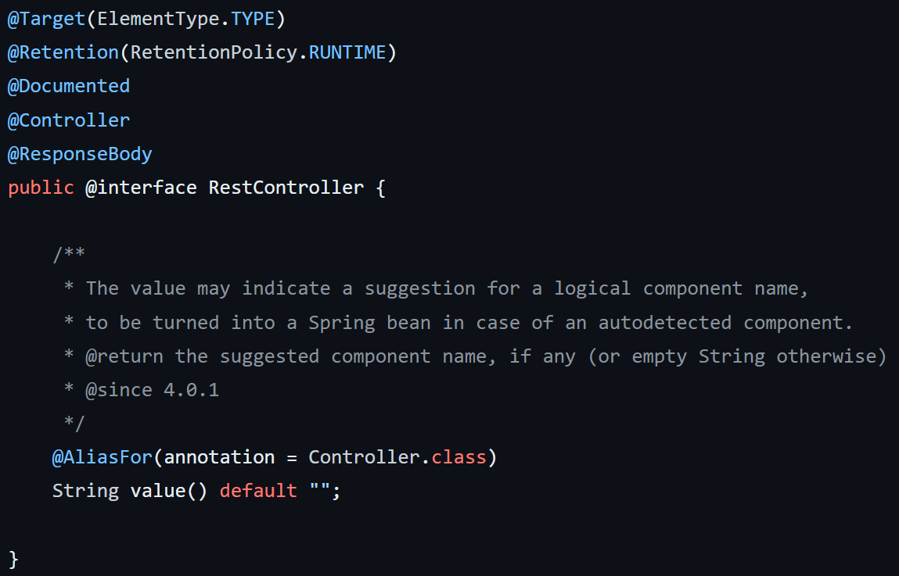
Overview - annotation
Presenter: 楊昕叡
Main functions can be accessed from AnnotationUtils.java and AnnotatedElementUtils.java: get/find annotations/informations about annotations/annotation attributes…
merged annotations
Annotations defined here:
@Aliasfor: aliases for annotation attributes
@Order: order for an annotated component when sorting

Slide 30
Design pattern outline
Presenter: 楊昕叡
Strategy pattern
Iterator pattern
Template method pattern
Singleton pattern
Null object pattern
Proxy pattern

Slide 31
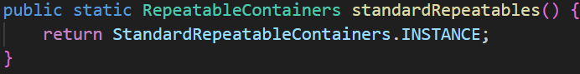
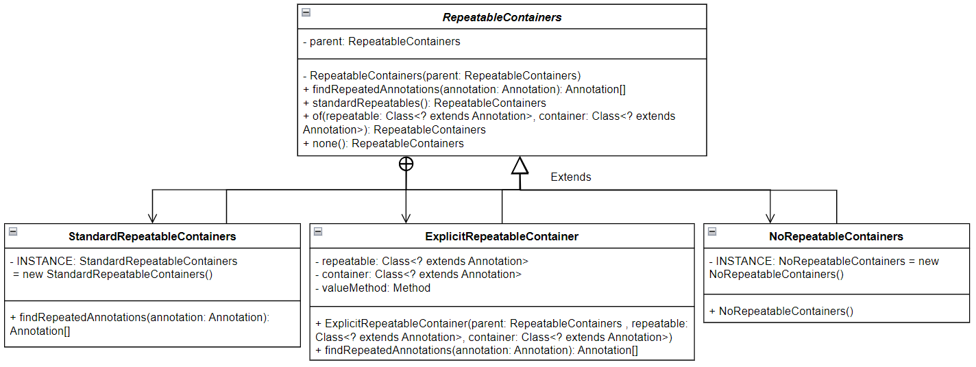
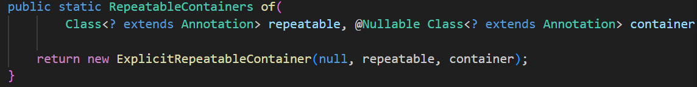
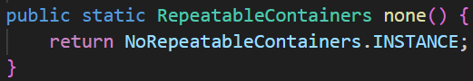
Strategy pattern - RepeatableContainers
Presenter: 楊昕叡
Clients can use standardRepeatables() or of() or none() to get suitable RepeatableContainers. Then clients can use polymorphism to call findRepeatableAnnotations(), which has different strategies to find all repeated annotations from an annotation.

Slide 32
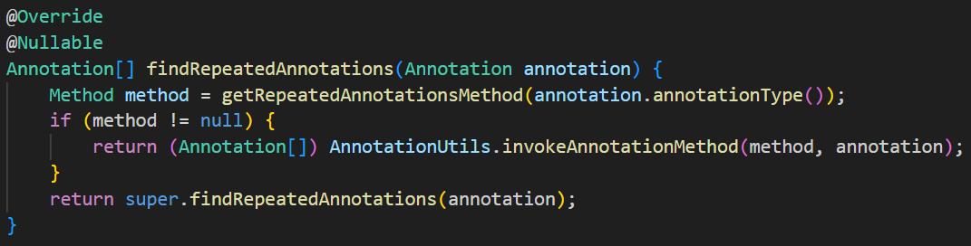
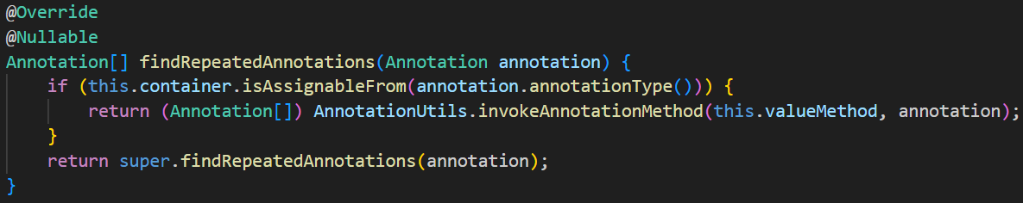
Strategy pattern - RepeatableContainers
Presenter: 楊昕叡
StandardRepeatableContainers: find through java @Repeatable
ExplicitRepeatableContainer: user-defined

Slide 33
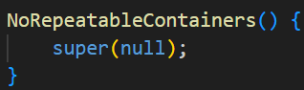
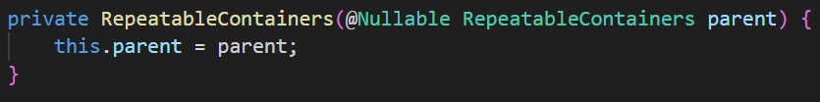
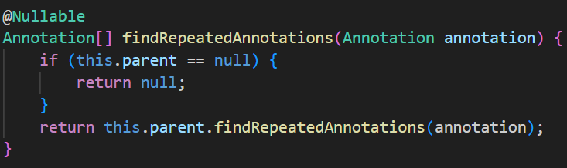
Strategy pattern - RepeatableContainers
Presenter: 楊昕叡
NoRepeatableContainers: null, it is a Repeatable container wit null parent, which will cause findRepeatableAnnotations() to return null.
its constructor:
RepeatableContainers’s constructor:
RepeatableContainers’s findRepeatableAnnotations():

Slide 34
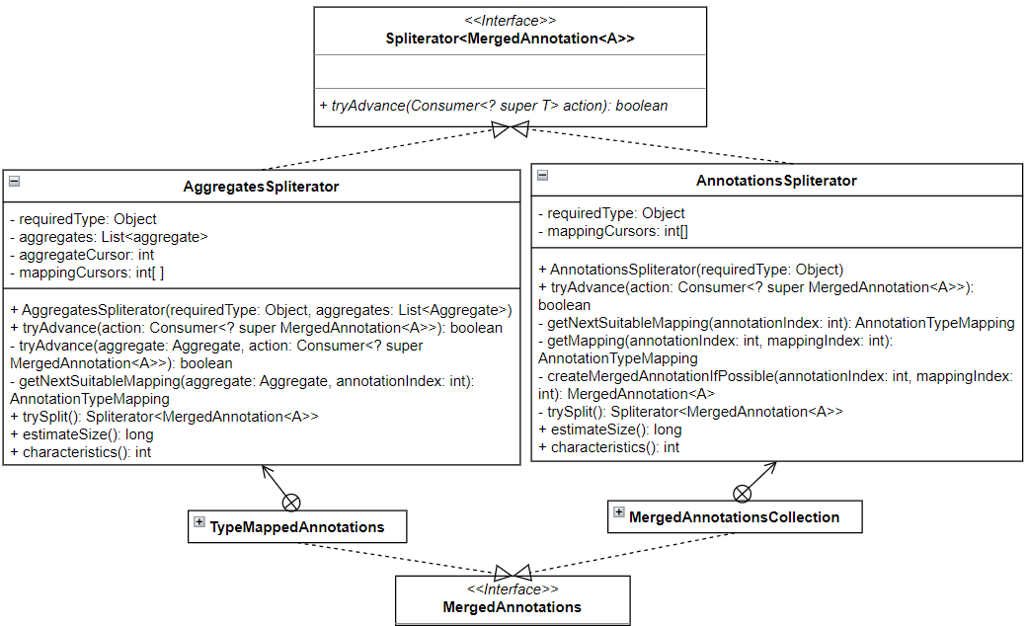
Iterator pattern - Spliterator
Presenter: 楊昕叡
tryAdvance() iterates Aggregates or a collection of MergedAnnotation.
Aggregate = List<Annotation>, each aggregate has source aggregate, so it forms a tree structure.
Annotations in a collection may not have relations between each other.
The annotation with lowest distance from root is traversed first.

Slide 35
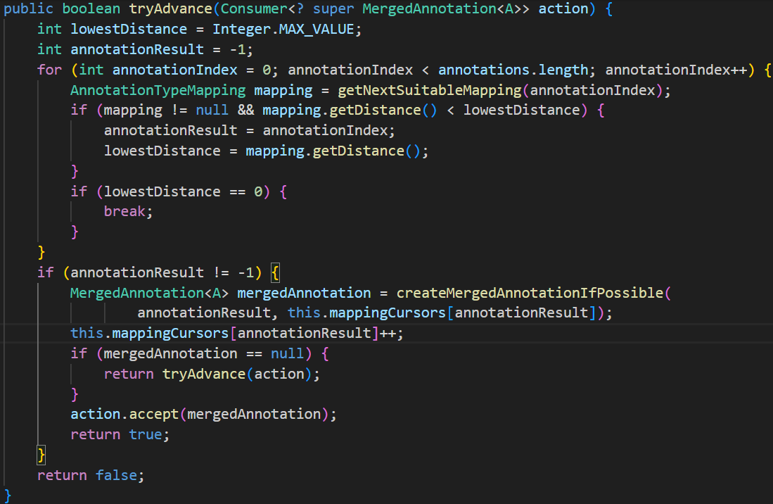
AnnotationsSpliterator.tryAdvance()
Presenter: 楊昕叡

Slide 36
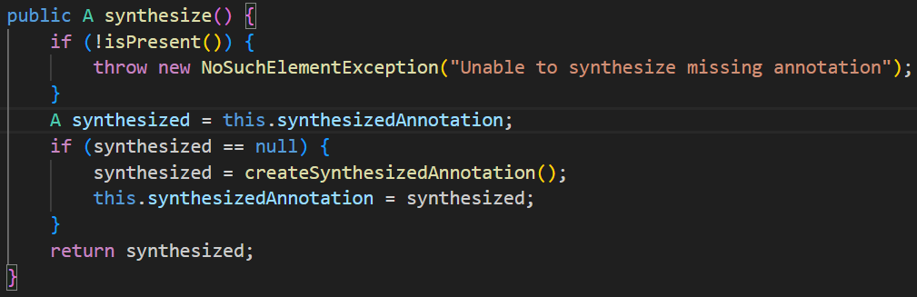
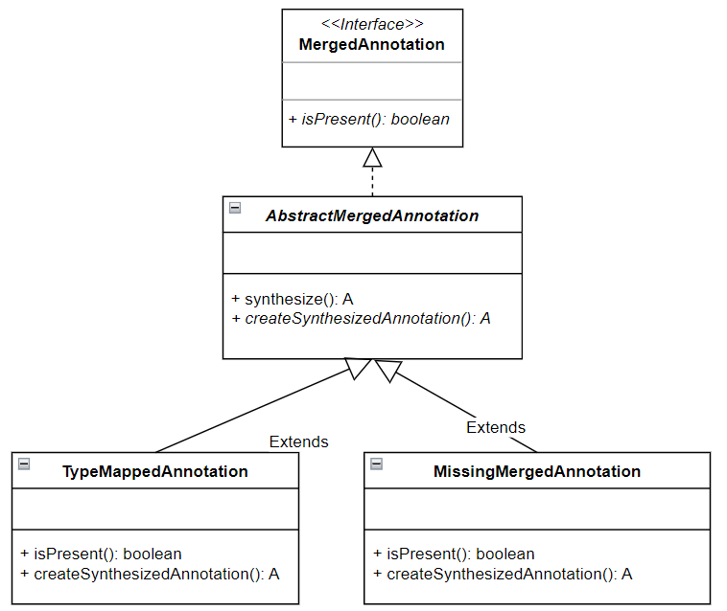

Template method pattern - AbstractMergedAnnotation
Presenter: 楊昕叡
synthesize() check !isPresent() and create synthesized annotation if needed.

Slide 37


Factory method pattern - createSynthesizedAnnotation()
Presenter: 楊昕叡
createSynthesizedAnnotation() is abstract in AbstractMergedAnnotation and TypeMappedAnnotation implements it, so it is a non-static factory, <A extends Annotation>
The implementation in MissingMergedAnnotation throws exception, so this is not a factory here.

Slide 38



Proxy pattern
Presenter: 楊昕叡
private constructor and invoke() handles methods related to annotations.

Slide 39



Null Object pattern - MissingMergedAnnotation
Presenter: 楊昕叡
return negative value, null or throw exception to indicate Null.

Slide 40


Singleton pattern - MissingMergedAnnotation
Presenter: 楊昕叡
eager creation
private Instance, constructor with a getInstance() method

Slide 41
Packages and Design Patterns
Presenter: 劉玠均
Week | Packages | Design Patterns
W2 - W6 | core/convert/ | Abstract Factory, Singleton, Adapter
W7 | core/MethodParameter.java
W8 - W9 | core/ResolvableType.java | Builder
W10 - W12 | core/type/ | Factory Method, Visitor
W13 | core/serializer/

Slide 42


core/convert
Conversion Service
Converters
8 Default converters
13 Collection converters
14 Scalar/Enum converters
Converter Factories
Notes:
Examples
Array/Collection/Object/String ToCollectionConverter
Array/Collection/Object/String ToArrayConverter
ObjectTo Collection/String Converter, StringTo Collection/String Converter
MapToMapConverter
StreamConverter

Slide 43


(Suppl.) Adapter Pattern
Presenter: 劉玠均
GenericConversionService.addConverter() use ConverterAdapter to adapt converter’s matches() and convert() function. The code snippets is as follows:

Slide 44

(Suppl.) Adapter Pattern
Presenter: 劉玠均
ConverterAdapter
matches: apply this.converter.matches() after the type check
convert: besides doing the same thing as matches(), it added a null handler at the front

Slide 45

(Suppl.) Adapter Pattern
Presenter: 劉玠均
ConverterFactoryAdapter
matches: get a concrete converter from the converter factory and the corresponding matches()function
convert: same as ConverterAdatper.convert()

Slide 46

Singleton Pattern - convert
DefaultConversionService

Slide 47

Abstract Factory Pattern - convert
Presenter: 劉玠均
ConverterFactory: get specific concrete converter by getConverter.

Slide 48

core/type
Presenter: 劉玠均

Slide 49


Factory Method Pattern - type
Presenter: 劉玠均
MetadataReaderFactory: create metadata reader via getMetadataReader.

Slide 50

Suppl. concrete layer?
Presenter: 劉玠均
The design pattern here should be Factory Method pattern not Abstract Factory. Because in core/classreading, there’s no multiple factories.
Hence, it is more like a static factory (i.e., SimpleMetadataReaderFactory) creates a product (i.e., SimpleMetadataReader)

Slide 51

Visitor Pattern - type
Presenter: 劉玠均
asm.ClassReader accepts ClassVisitor for visiting concrete Metadata via visit* functions.

Slide 52

Visitor Pattern - type/classreading
Presenter: 劉玠均
SimpleMetadataReader
These visit functions are used in asm.ClassReader.accept(classVisitor…)

Slide 53


Suppl. Other Concrete Visitors
Presenter: 劉玠均
The other two concrete visitors are MergedAnnotationReadingVisitor and SimpleMethodMetadataReadingVisitor; visit* functions are listed below.
Java Consumer allows Visitors to visit class. An example is SimpleMethod- MetadataReadingVisitor .visitEnd() as code below.

Slide 54

Builder Pattern - ResolvableType
Presenter: 劉玠均
ResolvableType contains multiple private constructors
VariableResolver use for* functions (e.g., forClass, forField) to build ResolvableType
Notes:
java reflect types: GenericTypeArray, ParameterizedType, TypeVariable, WildCardType

Slide 55

Builder Pattern (Adjust content)
Presenter: 劉玠均
Use forType(type: Type, typeProvider: TypeProvider, variableResolver: VariableResolver) to initialize the private constructor

Slide 56
Spring Framework Core - CGLIB
presenter: 林俊佑

Slide 57
System Overview (in cglib)
Presenter: 林俊佑
Proxy
Beans
Reflect
Core
Utils
Transform

Slide 58
System Overview (outside cglib)
Presenter: 林俊佑
Web Application
Spring AOP
CGLIB
ASM
JVM Bytes Code

Slide 59


Basic Step
Presenter: 林俊佑

Slide 60
Strategy Pattern
Presenter: 林俊佑
The implementation involves delegating the use of external tools when encountering specific algorithms.
When external tools encounter logic related to the implementation, they will invoke functions within the implementation itself.
Equipped with the ability to select external algorithms.
The external tools delegate back to the implementation, and there is mutual delegation between the implementation and the external tools.

Slide 61


Strategy Pattern
Presenter: 林俊佑
The implementation involves delegating the use of external tools when encountering specific algorithms.
When external tools encounter logic related to the implementation, they will invoke functions within the implementation itself.
Equipped with the ability to select external algorithms.

Slide 62

Template Pattern
Presenter: 林俊佑
break down an algorithm into a series of steps in Abstraction Class
subclass override steps which special for target object.
Diagram illustrating multiple classes inheriting from AbstractClassGenerator.

Slide 63


Template Pattern
Presenter: 林俊佑
break down an algorithm into a series of steps in Abstraction Class
subclass override steps which special for target object.

Slide 64

Builder Pattern
Presenter: 林俊佑
Simplify the object creation process.
Utilize inner static objects for creation.
BeanMap.Generator.create() <= easy
Diagram illustrating multiple classes inheriting from AbstractClassGenerator.
public static class Generator extends AbstractClassGenerator
public FastClass create() {
setNamePrefix(type.getName());
return (FastClass)super.create(type.getName());
}

Slide 65

Abstraction Factory Pattern
Presenter: 林俊佑
Use a factory interface to generate a series of related objects.
Actually create the objects by implementing subclasses of the factory.
CallbackGenerator[] generators = CallbackInfo.getGenerators(callbackTypes);
create an actual factory using a class.
gen.generate(ce, context, fmethods);
Use the factory to generate the corresponding object class.

Slide 66


Abstraction Factory Pattern
Presenter: 林俊佑
because of using visitor pattern,
do not need to return (emitter in context)

Slide 67

Double Checked Lock
林俊佑
Unique cache
static volatile Map<ClassLoader, ClassLoaderData> CACHE = new WeakHashMap<>();
static: shared
volatile: prevents compiler optimization, avoids race condition
WeakHashMap: GC may not necessarily clear

Slide 68

Visitor Pattern (in asm)
Presenter: 林俊佑
SymbolTable => Complex data structure
Invoke many visitors without returning
Unified export
ClassWriter cw = new ClassWriter(0);
cw.visit(...);
cw.visitField(...).visitEnd();
cw.visitField(...).visitEnd();
cw.visitField(...).visitEnd();
cw.visitMethod(...)).visitEnd();
cw.visitEnd();
byte[] b = cw.toByteArray();
SymbolTable is the Mapping of JVM Byte Code
In practice, `ClassWriter` holds all visitors and the `SymbolTable` as a unified entry point.
Visitors operate on the `SymbolTable` using their respective methods.
`ClassReader` unifies the export of results.

Slide 69

Visitor Pattern (in asm)
Presenter: 林俊佑
SymbolTable => Complex data structure
Invoke many visitors without returning
Unified export
exist different vistor

Slide 70


Proxy Pattern
Presenter: 林俊佑
CGLIB doesn't simply use the `ClassWriter` provided by ASM as an interface; instead, it use the Proxy pattern and writes its own interface.
Provide a proxy for other objects to control access to this object.
asm
Inherit from the same parent object, invoke methods of the original object, and add custom logic.
public void visitVarInsn() {
mv.visitVarInsn(opcode, remap(var, size));
}
sub class (asm)
sub class (cglib)

Slide 71

Proxy Pattern
Presenter: 林俊佑
Protection Proxy
Remote Proxy
Virtual Proxy
Smart Proxy : add additional actions when accessing the real object.

Slide 72

Bridge Pattern
Presenter: 林俊佑
Separate the abstract part from the implementation part, allowing them to vary independently.
Using CodeEmitter encapsulated and delegated by ClassEmitter afterward.
Avoid coupling between CGLIB and ASM, encapsulate the proxy object containing ASM logic, and delegate to the encapsulated object.
private CodeEmitter staticHook;
independent Delegate

Slide 73
Spring Framework Core - AOT
presenter: 陳君翰
Notes:
嗨！這邊要介紹的是 Spring core 裡面的 AOT
我會先簡介一下 AOT 的概念、這個 aot module 的實際功能、帶大家看過 class diagram，然後簡單講幾個這裡面用到的 design pattern
這邊的 design pattern 相對於前面的 core, gclib 真的少很多，我也會再等一下解釋這方面的原因

Slide 74
What is AOT
Presenter: 陳君翰
a technology to compile Java code ahead-of-time to a binary – a native executable.
In JIT (aka. the normal way)
javac: compile source code → bytecode (.class file)
java: interpret in runtime bytecode → executable.
support by JVM (Java Virtual Machine) “just-in-time” (JIT)
In AOT
javac: compile source code → bytecode (.class file)
native-image: compile bytecode → binary executable.
usually supported by Oracle GraavlVM
./executable to execute
binary executable, can only run on the same machine / OS
Notes:
好，這邊先解釋 AOT 到底是什麼

Slide 75
JIT vs. AOT
Presenter: 陳君翰
 | Pro | Con
Just in Time | “Write once, Run anywhere” JVM can dynamically adjust resource to reach best performance | Requires more resource (eg. memory) The JVM itself is huge, expensive to deploy. slow start-up
Ahead of Time | Small, standalone binary executable fast start-up | only run on similar machine / OS some functionality is limited

Slide 76
Spring AOT
Presenter: 陳君翰
Typical Spring Boot applications are quite dynamic and configuration is performed at runtime. To create native images, a closed-world is assumed and the dynamic aspects of the application are restricted.
When restrictions are in place, it becomes possible for Spring to perform ahead-of-time processing during build-time and generate additional assets that GraalVM can use.
Java source code
Bytecode (for dynamic proxies etc)
GraalVM JSON hint files:
Resource hints (resource-config.json)
Reflection hints (reflect-config.json)
Serialization hints (serialization-config.json)
Java Proxy Hints (proxy-config.json)
JNI Hints (jni-config.json)
Notes:
再來看到 Spring AOT，Spring 本身是相當動態的一個 framework，他本身是建構在 Inversion of Control 的理念下面，他底層其實一直在動態的拿 class 來注入，然後他時常在做 reflection, proxy, AOP，但這種動態的資源分配對於AOT 產生出的靜態執行檔是有困難的
因此呢，Spring 必須在某些條件下才能去做 AOT，這些條件可以去看他的 reference document。
條件達成之後，他會在 build time 去做分析，並且生成出下面這些檔案來協助 GraalVM 去真的生出來 binary 執行檔
這些輔助用的檔案包含 source code, bytecode, 還有各種 hint，像是 resource, reflection, serialization, proxy, jni hint 這些
我們可以發現，spring aot 這個模塊的本質是去「作為輔助，生產資源給GraalVM」，

Slide 77

Spring AOT Simplified Class diagram
Presenter: 陳君翰
Notes:
我們這邊能看到簡化過的 AOT class diagram，我只把主要的架構拿出來，有些輔助用的待會會再提到
我們可以看到整個架構的最上層是 Generation Context，在下一層是 GeneratedFiles, GeneratedClasses，這兩個就是剛剛講的 spring AOT 會生成輔助用 source code 的部分
旁邊是 runtime hint， hint 和剛剛講的一樣，就是 resource, serialization, proxy, reflection，他們內部又有更細的結構
我們可以發現，這東西更像是一個 data structure，他就只是拿來紀錄資訊最後生出檔案。
他本身不具備分析的功能，分析功能應該主要是在 spring-context
話雖如此，他還是有使用到一些 design pattern 讓他在組合資料上更有效率

Slide 78
System Overview
Presenter: 陳君翰
Generate
Hint
Nativex
Annotation
Feature
Predicate
Substitution
Support
Notes:
整個 module 可以被細分為三塊，上一頁 class diagram 是 generate 和 hint 兩個的綜合版
generate 是用來存生成出的 java source code，並把他寫出去成為檔案
hint 就是單純把 runtime hint 的資料架構存起來
nativex 則是把 hint 寫出來成為 json file
我這邊不會細講內部灰色方匡的小模塊，有點太雜

Slide 79

Module - generate
Presneter: 陳君翰
Notes:
剛剛有提到，這邊主要負責儲存和生出檔案，資料來源是來自 spring-context 那邊的分析結果
生檔案的部分，從最上層的 writeGeneratedContent() 一路呼叫下去，他會把 class 轉為 javafile，然後放進 GeneratedFiles
這邊比較複雜的是在 GeneratedClasses 開始有使用 javapoet 的 TypeSpec Builder 和 Consumer
如果這邊要講 design pattern，大概左邊的 GeneratedFiles 有種 Null Object Pattern 的味道

Slide 80

Module - hint
Presenter: 陳君翰
Notes:
接下來，這裡看到 hint module
剛剛有提過，他們就是存 5 種不同的 hint
我們可以看到有一堆人都有 inner builder class，內容上有些簡單有些複雜，複雜的部分像是 ReflectionHints 那邊結構複雜到他 hold reference 是反過來的，他會拿 TypeHint builder 為主體，然後慢慢去建構
我們這邊會拿比較簡單的 ProxyHint 來講 builder pattern

Slide 81

Builder Pattern
Presenter: 陳君翰
(Added After Presentation)
This builder is the builder pattern for immutable object.
The builder is the inner class of the product.
The attributes of the product are final.
The constructor of the product is private, and takes the its builder as its input.
Notes:
這邊以 JdkProxyHint 為例，這是一個比較簡潔的 Builder Pattern
可以看到上面的 JdkProxyHint 的 constructor 是 private 的，所以無法被外部使用
但是可以用 JdkProxyHint 的 static function 來生成 builder，或直接設定 builder
最後，想建立 JdkProxyHint 的時候，再使用 builder （點）.build() ，private constructor 才能從 builder 拿資料

Slide 82

Module - nativex
Presenter: 陳君翰
NativeConfigurationWriter: write each hint to their corresponding .json file

Slide 83

Singleton Pattern (Eager Creation, Not Classic)
Presenter: 陳君翰
no private instance, public getInstance()
constructor is still public
Notes:
好，然後 AOT 的部分就先到這邊，最後簡單總結一下

Slide 84
Summary

Slide 85
Summary
Presenter: 陳君翰
Here are all the design pattern we have seen in spring framework core
Creational | Structural | Behavioral
Factory Method Abstract Factory Singleton Builder | Adapter Decorator Composite Proxy Bridge | Iterator Null Object Strategy Template Method Visitor
Notes:
我們這邊重新整理了一下剛剛有提到的 design pattern
老師上課所提過的 pattern 幾乎都至少出現過一次，我們覺得這真的是非常有趣的一件事情
我們也認識到這些 pattern 對於整個 framework 的重要性，他們的存在必然幫助許多開發者者省下很多時間和資源，是 spring framework 開發的重要基石，也是讓整個 spring 能夠穩步邁向成功的重要因素
以上，我們第二組的報告到此結束，謝謝大家！

Slide 86
The End

Slide 87
Source
Ahead of Time Optimization. In Spring Framework Reference Documentation. Spring.
GraalVM Native Image Support. In Spring Boot Reference Documentation. Spring.

